Slide 1
計算機程式設計一:Coding Style

Slide 2
Outline
Introduction
Making your programs readable
Layout
Declarations
Names
Comments
Using one line per statement
Using blank lines to separate sections

Slide 3
Making your programs readable
Easier to understand, correct or modify them
Helps clarify your own concept of them

Slide 4
Outline
Introduction
Layout
Braces
Indents
Declarations
Names
Comments
Using one line per statement
Using blank lines to separate sections

Slide 5
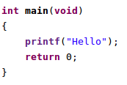
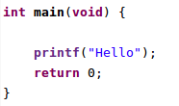
Braces
Style 1
Style 2
Note:
style1的前後括號和style2的後括號對齊 int main(void) 的前端。
style2的前括號置於 int main(void) 後，其間以空格隔開。
選定其中一種風格後，在程式碼內，則統一使用該風格。

Slide 6
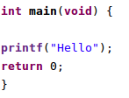
Indents
Indent 4 spaces per level
E.g. (O)
E.g. (X)

Slide 7
Outline
Introduction
Layout
Declarations
Names
Comments
Using one line per statement
Using blank lines to separate sections

Slide 8
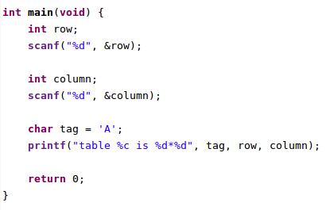
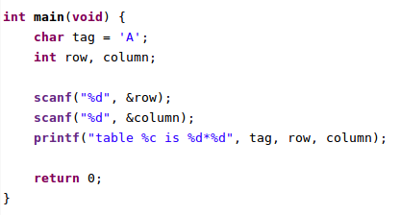
Declarations
Declare variables at the top of the function
Declare one variable per line if it is initialized
Only use comma separated lists of variables in a declaration when they are related
E.g.
(X)
(O)

Slide 9
Outline
Introduction
Layout
Declarations
Names
Comments
Using one line per statement
Using blank lines to separate sections

Slide 10


Names
Choose meaningful variable names
E.g. (O)
E.g. (X)
Note:
Other people cannot realize the meaning of the variables if there are no comments.

Slide 11
Outline
Introduction
Layout
Declarations
Names
Comments
Using one line per statement
Using blank lines to separate sections

Slide 12

Comments
Use comments to make other people understand your program
Comments are also useful to yourself if your program is large
E.g.
One-line comment
Multi-line comment
Note:
You can also use many one-line comments for a multi-line comment
It is better to put comments at the start of each line if they are sentences

Slide 13
Outline
Introduction
Layout
Declarations
Names
Comments
Using one line per statement
Using blank lines to separate sections

Slide 14
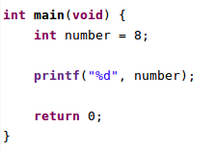
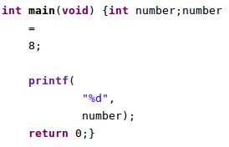
E.g. (O)
E.g. (X)
Note:
Although C compiler can accept the code, it is very unreadable

Slide 15
Outline
Introduction
Layout
Declarations
Names
Comments
Using one line per statement
Using blank lines to separate sections

Slide 16
In a block, if there are many sections like declaration section, action section, another action section, …, it is better to separate them by blank lines

